Slide 1
Mock Face-Name Memory IQ Task

Slide 2

Good with names and faces?
Let’s investigate a type of face-name memory IQ
We often experience trouble remembering the name of a person we have previously met despite recognizing their face as being familiar.
The ability to successfully remember face-name pairings can be termed face-name memory IQ.
If you would like to test this type of face-name memory IQ, please hit ‘Continue’ to proceed to our experiment.
Continue

Slide 3
Welcome to the Face-Name Memory IQ Project
You will be asked to complete two parts of the study and provide some anonymous information.
At the end you will receive an estimate of a type of Memory Face-Name IQ, which reflects how well you did compared to everyone else who has completed the experiment.
Additionally, you will have the opportunity to be tested on some of the face-name pairs tomorrow to receive a measure of your long-term face-name memory IQ
The study has been approved by the Washington University Psychology Research Ethics Committee, and only takes 10 to 15 minutes to complete.
Next

Slide 4

In order to use your anonymous data in our research, we need your consent to the following points:
I understand that my participation in this study is voluntary and that I am free to withdraw at any time, without giving any reason.
I agree that the data provided will be stored anonymously and included in a Washington University Cognitive Psychology Laboratory study
Click ‘I agree’ to indicate your consent and start the experiment.
I agree

Slide 5
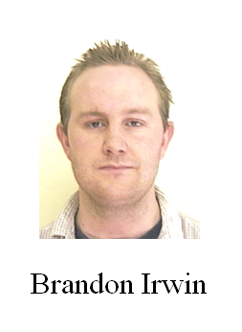
Face-Name Memory IQ Study: Part 1
Example: Study Phase
A picture of a face will appear in the center of the screen paired with its corresponding name, as shown in the diagram.
You will be given 2 seconds to learn the face-name pairing before you will proceed to the next face-name pair. You will be presented a total of 56 face-name pairs.
Your task is to learn the items so that you can identify on a later test whether you learned a particular face-name combination during the study phase.
Begin

Slide 6
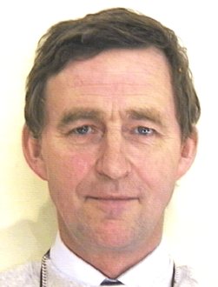
Anthony Foster

Slide 7
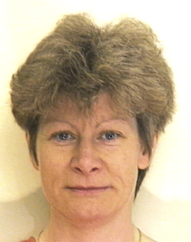
Laura Hamilton

Slide 8
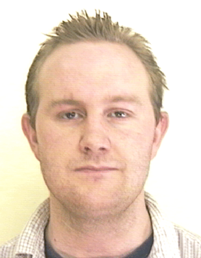
Brandon Irwin

Slide 9
You have finished with the Study Phase
Continue

Slide 10
Demographics
Thanks for completing the study so far!
In order to use your responses as part of our experiment we need some information. Before proceeding onto the last portion of the study, please complete the following:
1) Which country are you a resident of?
2) How old are you?
3) What is your gender?
4) Are you right or left handed? (right; left; ambidextrous)
5) What is your highest level of education? (select from a drop down menu)
6) What time of day do you feel most alert? (morning, afternoon, evening, no differences)
7) What racial category best applies to you? (American Indian/Alaskan Native; Asian; Native Hawaiian or Other Pacific Islander; Black/African American; White/Caucasian; more than one race; prefer not to respond)
8) Do you consider yourself to be Hispanic or Latino? (yes; no; prefer not to respond)
9) What is your native language? (select from a drop down menu)
Continue

Slide 11
Test Phase: Part 2
In the following section you will be presented with face and name pairs in the center of the screen, one at a time. You will make one of two judgments about the face-name combination on the screen:
a) Old, it is an old face-name pair that you studied;
b) New, it is a totally new face and name.
When you are ready to begin the test phase, please press the begin button.
Begin

Slide 12
Anthony Foster
OLD
NEW
Notes:
In this case, the participant should press the “old” button.

Slide 13
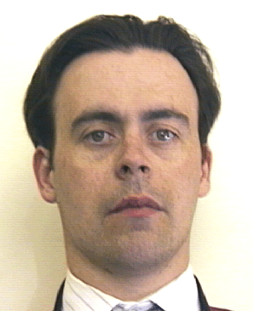
Pete Miller
OLD
NEW
Notes:
In this case, the participant should press the “new” button because face-name pair was never presented during the study phase

Slide 14
Your Face-Name Memory IQ:
How do your results measure up to others who have taken our test?
Your memory IQ score: ____
__% of the people taking this task have performed at the same level or lower than you did.
You correctly identified __% of items that were studied during the study phase, and correctly rejected ___% of the face-name pairs.
Note: your face-name memory IQ score is based on the scores of people who have completed this task thus far. This memory IQ score is one of many types of measures of memory.
Share link with friends
Participate in second part of study tomorrow
End
Notes:
The “share link with friends” button would allow them to email the link for the experiment to other people who might be interested in completing the task. “participate in second part of study tomorrow” will lead to slide 15, where they give us their email address. “End” button will go to the final slide.

Slide 15
Thank you for your interest in participating in the long-term memory part
of this study.
Please enter your email address below so that a member of our research
team can email you a link for the second part of the study,
where you will be able to obtain your long term face-name memory IQ.
Note, the email address will only be available to
members of our research team and will not be distributed to anyone else.
If you decide that you do not want to participate in our study, you
may discontinue being contacted/participating at any time.
Done entering email address

Slide 16
Thank you for your participation!
This experiment investigated a memory for faces and names. We are hopeful that by examining a large number of participants, we will be better able to understand the variability across people in this important social skill. Please tell your friends about our study by forwarding the link:
PUT LINK HERE
Back

